Slide 1
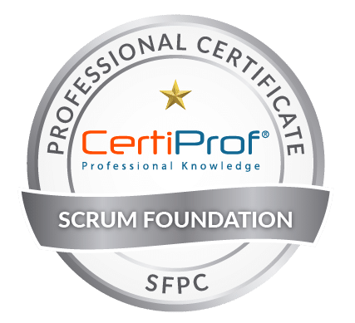



SCRUM
Mohamed Amine MEZGHICH
Scrum Master & Product Owner Certfied
Scrum Foundation Professionl & Scrum Master Certified
ma.mezghich@smart-it-partner.com

Slide 2
Outlines
Definition of SCRUM
Uses of SCRUM
Scrum Values
Scrum Team
Scrum Events
Scrum Artifacts

Slide 3
Purpose of the Scrum Guide
Scrum is a framework for developing, delivering, and sustaining complex products.
The definition of Scrum consists of Scrum’s roles, events, artifacts, and the rules that bind them together. Ken Schwaber and Jeff Sutherland developed Scrum; the Scrum Guide is written and provided by them. Together, they stand behind the Scrum Guide.

Slide 4
Definition of SCRUM
A framework within which people can address complex adaptive problems, while productively and creatively delivering products of the highest possible value.
Scrum is:
• Lightweight
• Simple to understand
• Difficult to master

Slide 5
Definition of SCRUM
Scrum is a process framework that has been used to manage work on complex products since the early 1990s.
Scrum is not a process, technique, or definitive method. Rather, it is a framework within which you can employ various processes and techniques. Scrum makes clear the relative efficacy of your product management and work techniques so that you can continuously improve the product, the team, and the working environment.
The Scrum framework consists of Scrum Teams and their associated roles, events, artifacts, and rules. Each component within the framework serves a specific purpose and is essential to Scrum’s success and usage.

Slide 6
Uses of SCRUM
Scrum was initially developed for managing and developing products. Starting in the early 1990s, Scrum has been used extensively, worldwide, to:
1. Research and identify viable markets, technologies, and product capabilities;
2. Develop products and enhancements;
3. Release products and enhancements, as frequently as many times per day;
4. Develop and sustain Cloud (online, secure, on-demand) and other operational environments for product use; and,
5. Sustain and renew products.

Slide 7
Uses of SCRUM
Scrum has been used to develop software, hardware, embedded software, networks of interacting function, autonomous vehicles, schools, government, marketing, managing the operation of organizations and almost everything we use in our daily lives, as individuals and societies.
Scrum employs an iterative, incremental approach to optimize predictability and control risk.
Three pillars uphold every implementation of empirical process control: transparency, inspection, and adaptation.

Slide 8
Uses of SCRUM
Transparency : Significant aspects of the process must be visible to those responsible for the outcome. Transparency requires those aspects be defined by a common standard so observers share a common understanding of what is being seen.
For example
• A common language referring to the process must be shared by all participants; and,
• Those performing the work and those inspecting the resulting increment must share a common definition of “Done”.

Slide 9
Uses of SCRUM
Inspection : Scrum users must frequently inspect Scrum artifacts and progress toward a Sprint Goal to detect undesirable variances. Their inspection should not be so frequent that inspection gets in the way of the work.
Inspections are most beneficial when diligently performed by skilled inspectors at the point of work.

Slide 10
Uses of SCRUM
Adaptation : If an inspector determines that one or more aspects of a process deviate outside acceptable limits, and that the resulting product will be unacceptable, the process or the material being processed must be adjusted. An adjustment must be made as soon as possible to minimize further deviation.
Scrum prescribes four formal events for inspection and adaptation:
• Sprint Planning
• Daily Scrum
• Sprint Review
• Sprint Retrospective

Slide 11
Scrum Values
When the values of commitment [1], courage [2], focus [3], openness[4] and respect[5] are embodied and lived by the Scrum Team, the Scrum pillars of transparency, inspection, and adaptation come to life and build trust for everyone.
The Scrum Team members learn and explore those values as they work with the Scrum roles, events, and artifacts.

Slide 12
Scrum Values
Successful use of Scrum depends on people becoming more proficient in living these five values. People personally commit to achieving the goals of the Scrum Team. The Scrum Team members have courage to do the right thing and work on tough problems. Everyone focuses on the work of the Sprint and the goals of the Scrum Team. The Scrum Team and its stakeholders agree to be open about all the work and the challenges with performing the work. Scrum Team members respect each other to be capable, independent people.

Slide 13
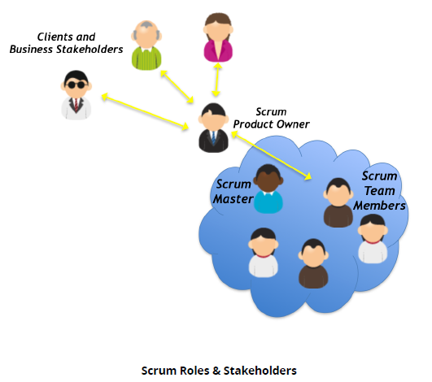
SCRUM Team
The Product Owner
The Development Team
The Scrum Master(Garant)

Slide 14
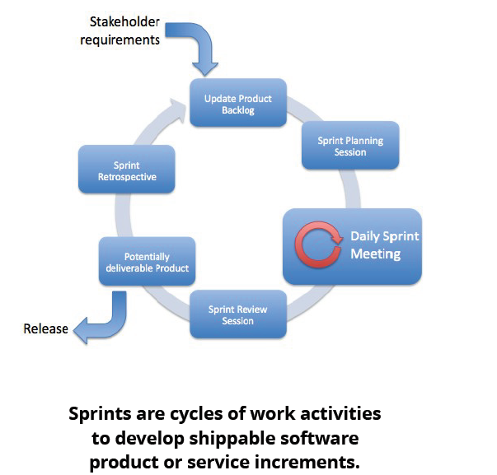
Scrum Events
The Sprint
Sprint Planning
Daily Scrum
Sprint Review
Sprint Retrospective

Slide 15
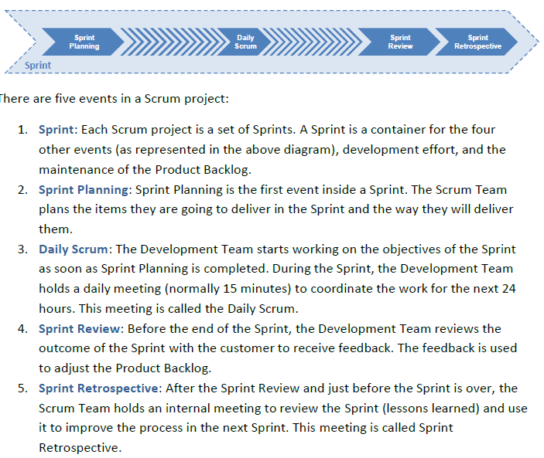
Scrum Events
The Sprint
Sprint Planning
Daily Scrum
Sprint Review
Sprint Retrespective

Slide 16
Scrum Artifacts
Product Backlog
Sprint Backlog
Increment
Definition of Done (DoD)

Slide 17
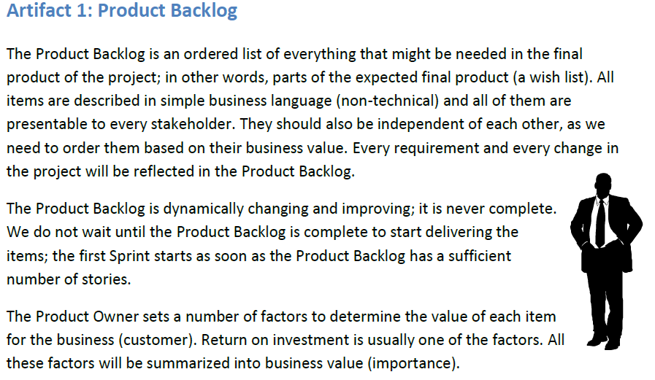
Scrum Artifacts
Product Backlog
Sprint Backlog
Increment
Definition of Done (DoD)

Slide 18
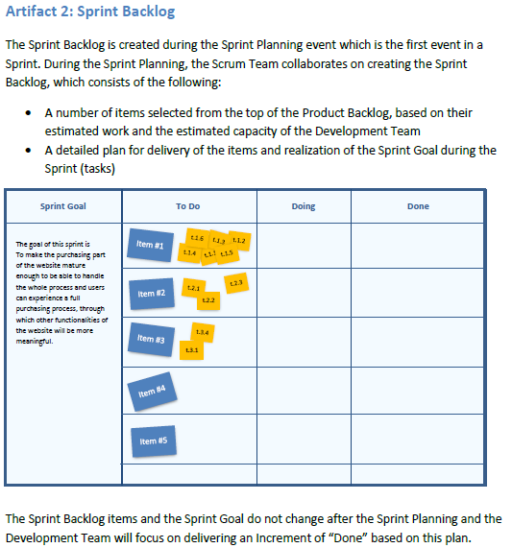
Scrum Artifacts
Product Backlog
Sprint Backlog
Increment
Definition of Done (DoD)

Slide 19
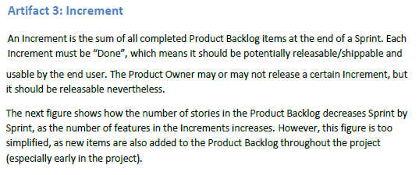
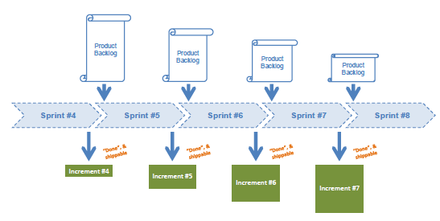
Scrum Artifacts
Product Backlog
Sprint Backlog
Increment
Definition of Done (DoD)

Slide 20
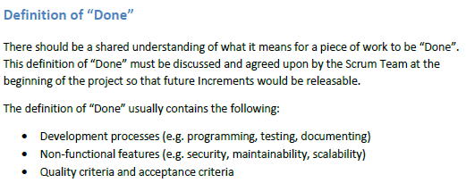
Scrum Artifacts
Product Backlog
Sprint Backlog
Increment
Definition of Done (DoD)

Slide 21
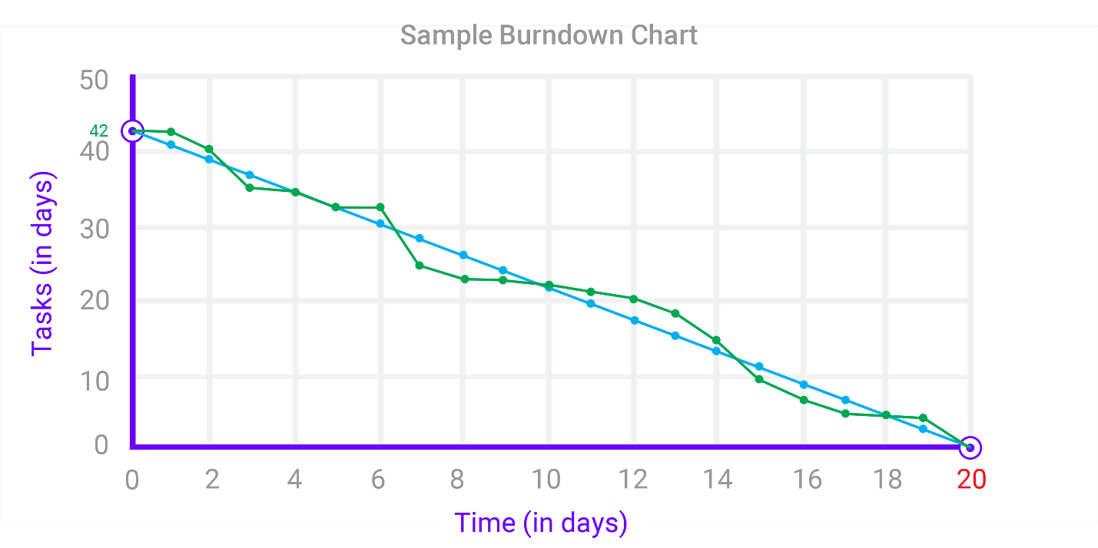
Burndown Scrum chart

Slide 22
References
Book [1] : The Scrum Guide : The Definitive Guide to Scrum: The Rules of the Game ; Developed and sustained by Scrum creators: Ken Schwaber and Jeff Sutherland
https://www.scrumguides.org/docs/scrumguide/v2017/2017-Scrum-Guide-US.pdf
Book [2] :The Scrum framework training Book ; Third Edition By International Scrum Institute™
www.scrum-institute.org

Slide 23
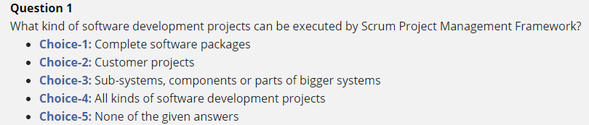
Questions

Slide 24

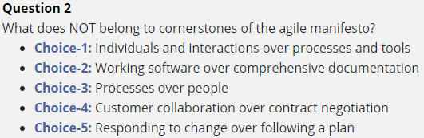
Questions

Slide 25

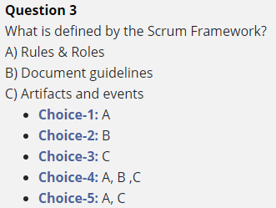
Questions

Slide 26

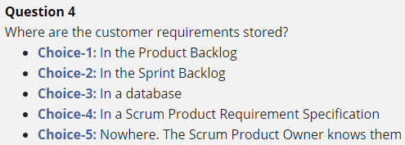
Questions

Slide 27

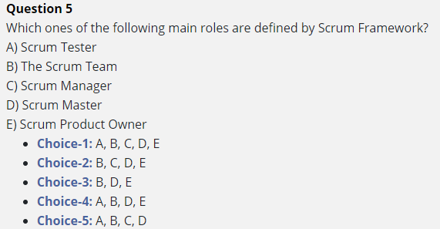
Questions

Slide 28

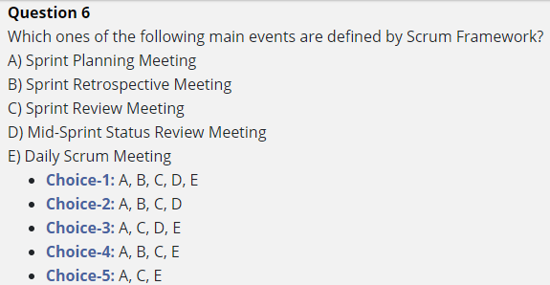
Questions

Slide 29

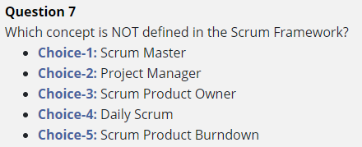
Questions

Slide 30
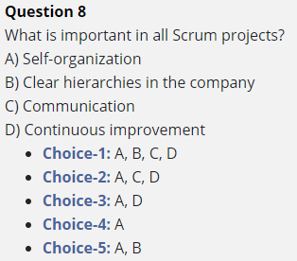

Questions

Slide 31

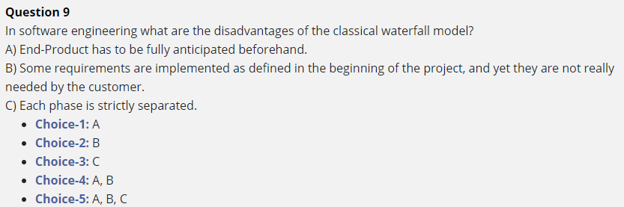
Questions

Slide 32
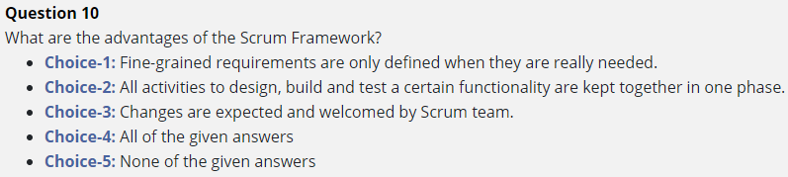
Questions

